Slide 1



Integrated Flood and Landslide Risk Assessment and Response System for Sri Lanka
Predict. Warn. Respond.
Building a safer Sri Lanka through intelligent risk assessment and timely action
PROJECT ID
J26-IT-334

Slide 2
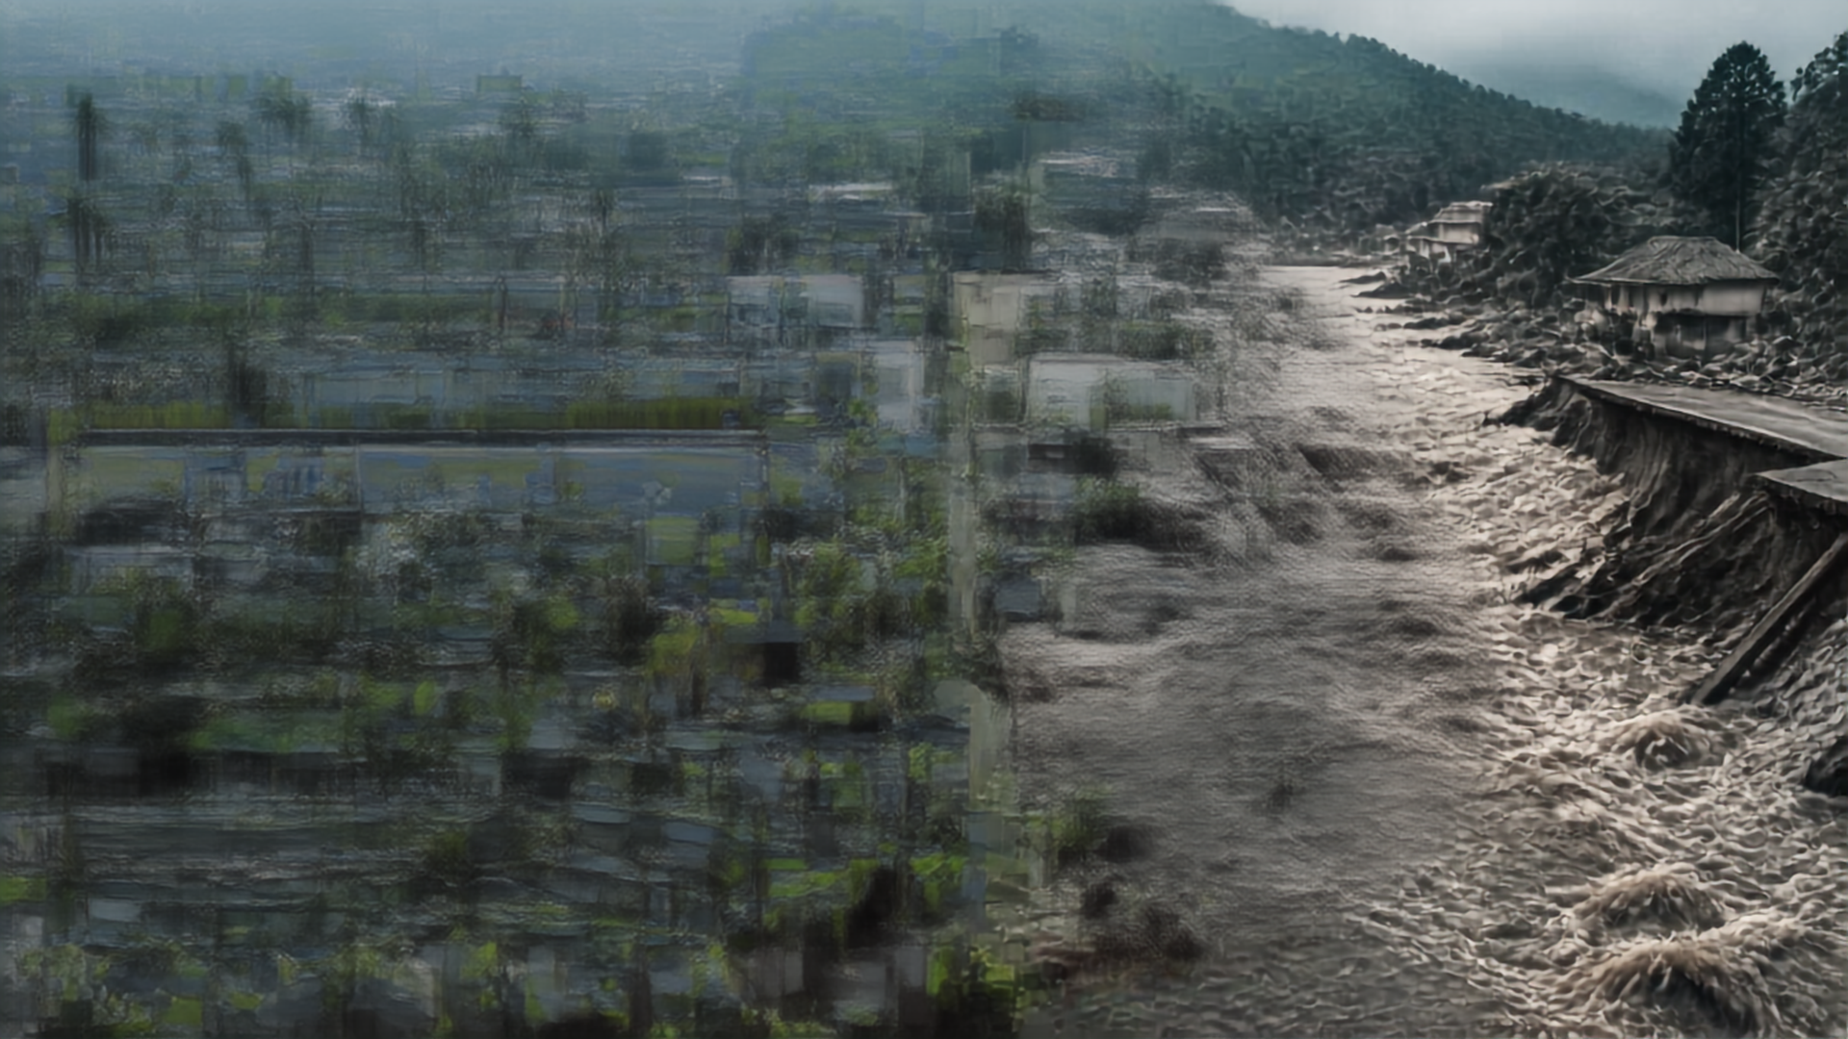


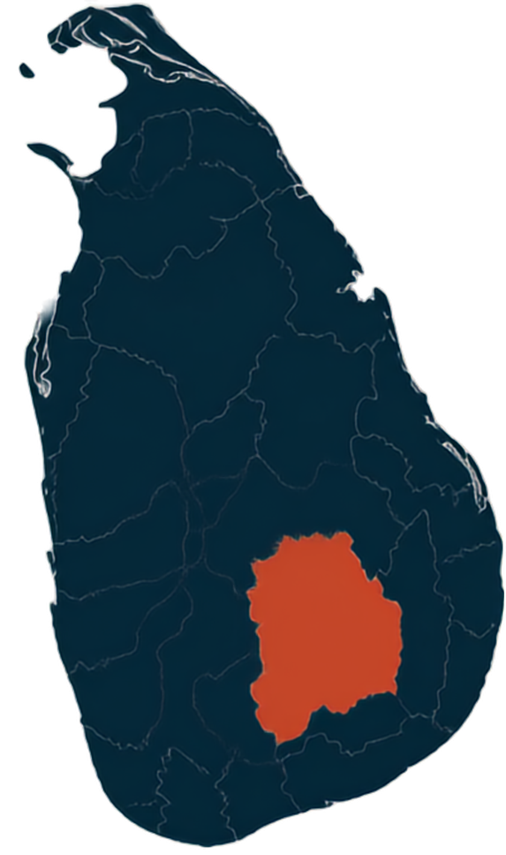



PROBLEM
STATEMENT
Recurring flood and landslide disasters with fragmented, reactive response
Frequent floods and landslides lead to loss of life, infrastructure damage, transport disruption and economic losses
Kegalle
Nuwara Eliya
High-risk regions: Ratnapura, Kegalle, Badulla, Nuwara Eliya
Driven by monsoon rainfall, urbanization, deforestation, land use changes and climate variability
Ratnapura
Badulla
Current systems from DMC, Met Dept and NBRO operate separately, focus on single hazards and respond after events occur

Slide 3
















SOLUTION
OVERVIEW
One connected system across prediction, impact assessment, decision support and response coordination
Four components working together to identify flood & landslide risks, estimate impacts, and support emergency actions
Our objective: timely, explainable, inclusive alerts and prioritized response recommendations for Sri Lanka
1
2
3
4
PREDICTION
ASSESSMENT
DECISION SUPPORT
RESPONSE
Forecast flood and landslide hazards
Estimate impacts on people, assets and infrastructure
Analyze risks, prioritize areas and recommend actions
Coordinate alerts, resources and field operations

Slide 4

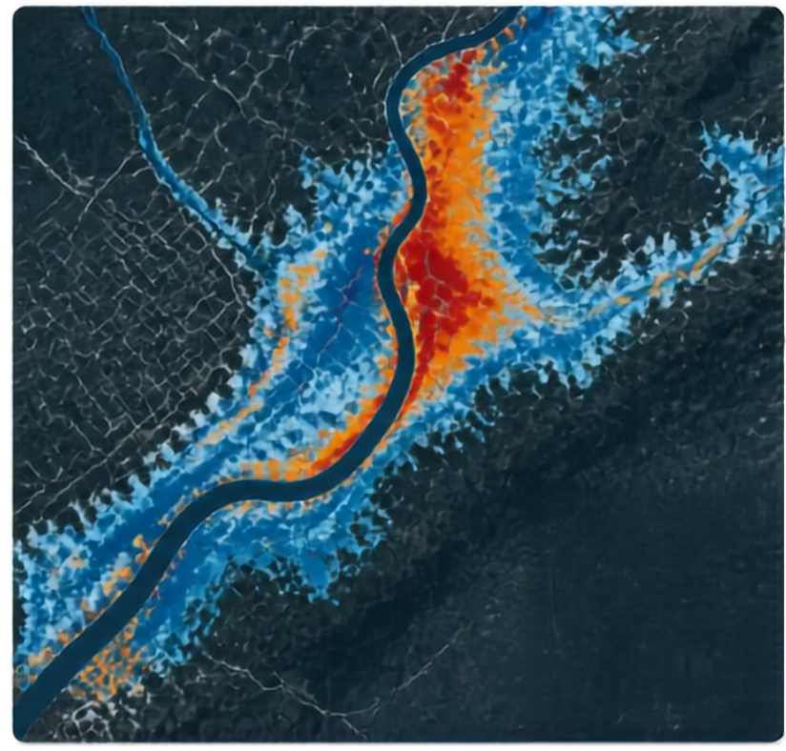













COMPONENT 1
Flood Severity Assessment & Mapping
DATA INPUTS
rainfall
river levels
satellite imagery
digital elevation model
historical floods
land use
population
PROCESSING
multi-source geospatial data preprocessing and fusion
ai/ml models with explainable risk factors
OUTPUTS
Flood Severity
flood extent and severity estimation
Low
affected population, buildings and infrastructure
Moderate
dynamic severity/risk maps for evacuation planning
High
satellite validation and updates
Very High

Slide 5




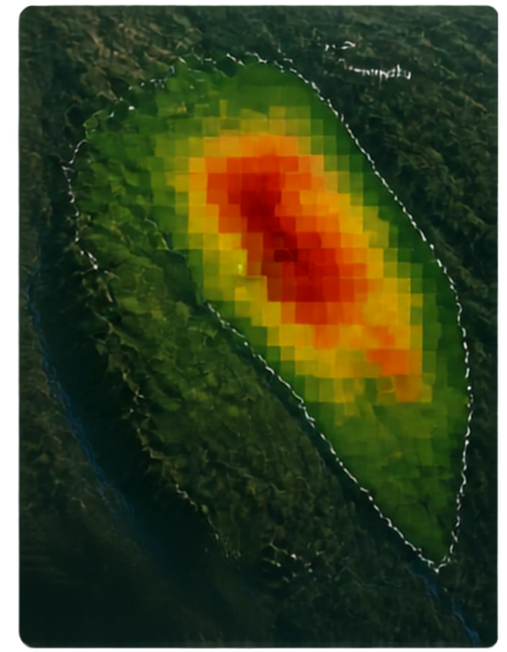








COMPONENT 2
PROBABILISTIC
Nuwara Eliye District
Walapane
LANDSLIDE ASSESSMENT
& FORECASTING
EXPLAINABILITY (SHAP)
Top factor contributions
Rainfall intensity
+0.38
Soil saturation
+0.27
Slope gradient
+0.19
Elevation
-0.12
Machine learning and explainability with accessible alerts
KandV
Land cover (forest)
-0.99
Drainage condition
-0.77
Real-time landslide probability from provincial to village scale
Slope cutting
-0.06
Nawalapitiya
Probability
Time
Risk level
Explainable AI shows environmental and human factor contributions
0.78
HIGH
NOW
Web-GIS/3D maps with Sinhala/Tamil dual-language alerts
wainwist wry, gynostegia gynogynic gynogynic
Landscape probability
moralise unmysticized, unmoralized unmysticized, unmoralized
Powered by Random Forest/XGBoost, PostGIS, Leaflet/MapLibre, WebGL
Low
High

Slide 6


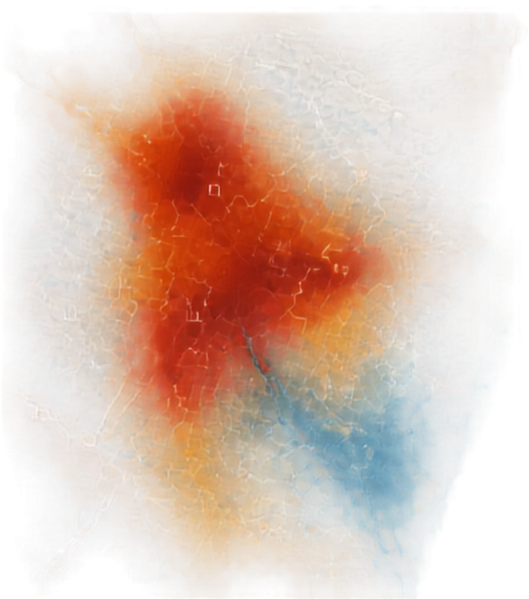













COMPONENT 3
HUMAN IMPACT & DECISION SUPPORT
HIGH PRIORITY
High hazard
High population
Critical facilities nearby
Integrating hazards with people and infrastructure to guide smarter, faster response
MEDIUM PRIORITY
Moderate hazard
Vulnerable groups
Limited access
Merges flood and landslide hazards with population density, vulnerable groups and socio-economic vulnerability
Accounts for critical facilities, road access, historical events and uncertainty
LOW PRIORITY
Low hazard
Lower exposure
Good access
Models joint and cascading risk with temporal overlap
Generates explainable priority scores
Delivers graded alerts, recommended actions and prioritized response zones
Hospitals
Schools
Shelters
Flood
Landslide

Slide 7





























COMPONENT 4
EMERGENCY RESPONSE & RESOURCE COORDINATION
Real-time resource-aware dispatch and routing innovations
PRIORITIZED ALERTS IN
LIVE RESOURCE AVAILABILITY CHECK
URGENCY QUEUING DURING SCARCITY
RESOURCE ALLOCATION ENGINE
HAZARD-AWARE ROUTE PLANNING
RESOURCE POOL
DISPATCH & COMMUNICATE
RESCUE BOATS
AMBULANCES
SHELTERS
SUPPLIES
SMS
APP
ALERTS
INNOVATION AT THE CORE
MONITOR & TRACK IN REAL TIME
Real-time resource-aware dispatch
Dual-route optimization across hazards
Scarcity-based queuing for fair prioritization
Multi-channel, localized communication
ARRIVALS & DEPLOYMENTS
SHELTER OCCUPANCY
RESOURCE UTILIZATION

Slide 8

























SYSTEM
ARCHITECTURE
One integrated platform. Connected components. End-to-end response.
Dashboards
Flood module
Web-GIS
Joint risk & impact prioritization
API gateway
Multi-source data & live telemetry
Data integration
GIS layers
Alerts
Landslide module
Reports
Resource coordination
Routing & dispatch
Citizens
DMC / Authorities
Partner Agencies

Slide 9






TEAM AND SUPERVISORS
Sinhalagoda S.A.U.R.A.V
(IT23280892)
Flood risk prediction & mapping
Bagya R M S
(IT23394124)
ML landslide forecasting
Prathibhani Y.L.O.L (IT23317512)
Human impact & decision support
Palihena M.B
(IT23411562)
Emergency response & resource coordination
SUPERVISORS
PROJECT ID
PROJECT TITLE
Dr. Kapila Dissanayaka (Supervisor)
J26-IT-334
Integrated Flood and Landslide Risk Assessment and Response System for Sri Lanka
Mr. Uchira Wickramarathne (Co-Supervisor)

Slide 10


THANK YOU
PREDICT. WARN. RESPOND.
Together, we build a safer Sri Lanka through data, coordination and action.
LET’S STAY CONNECTED
For collaboration, information sharing and next steps, please get in touch.
NBRO LIRIS
ReliefWeb/OCHA
Sri Lanka floods & landslides
Dept. Meteorology
Sri Lanka
DMC
flood warning
UNDRR
Sendai Framework
Palliyagurre et al.
(ICTer 2020)
Aththanayake et al.
(SLAAI-ICAI 2025)

